Slide 1
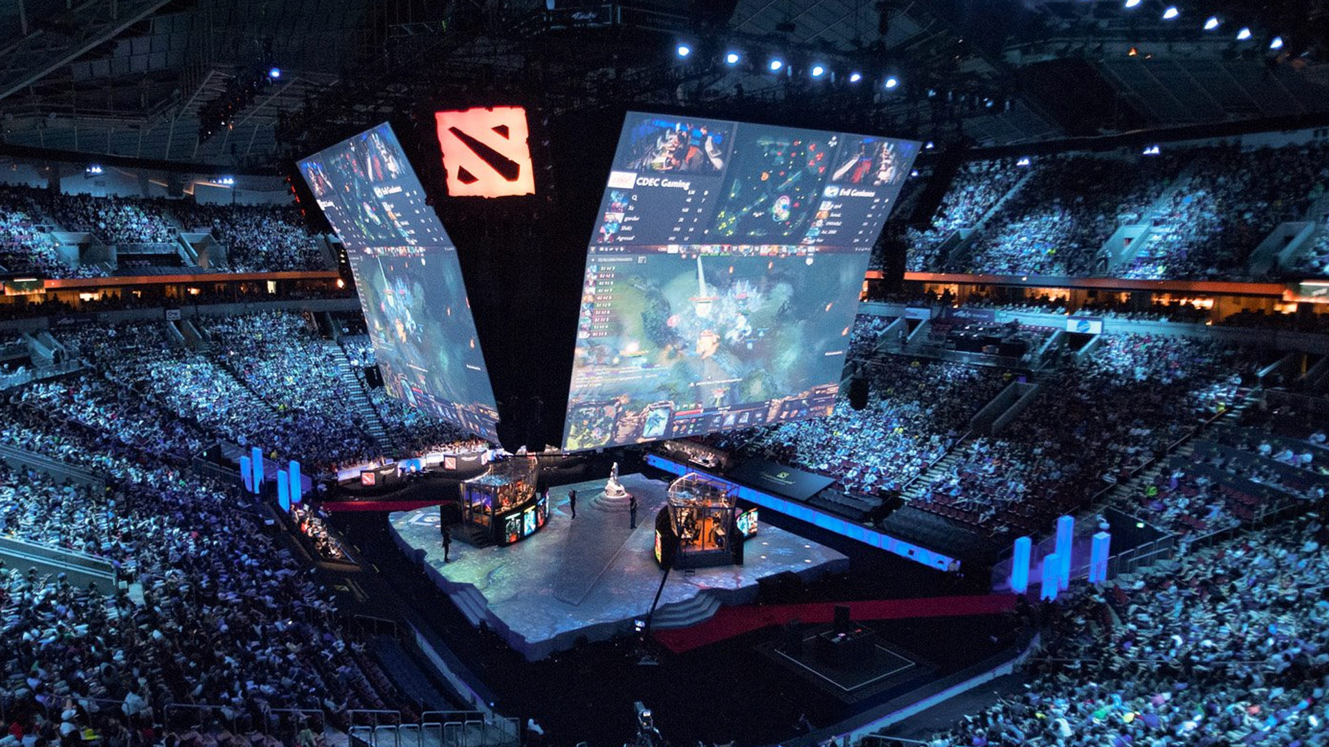
eSports
THE BIGGEST SPORTS YOU’VE PROBABLY NEVER HEARD OF

Slide 2
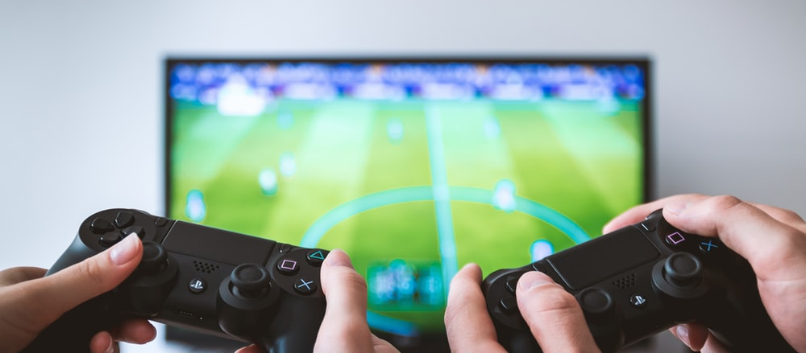

WHAT IS eSPORTS?
Esports (also known as electronic sports) is a form of competition using video games. Esports often takes the form of organized, multiplayer video game competitions, particularly between professional players, individually or as teams.

Slide 3

THE NUMBERS

Slide 4

THE PEOPLE ARE HERE.
An explosive trend of millions of fans around the world watching people play video games.
71 MILLION
The number of people who watch competitive video gaming as a spectator sport in Asia.

Slide 5
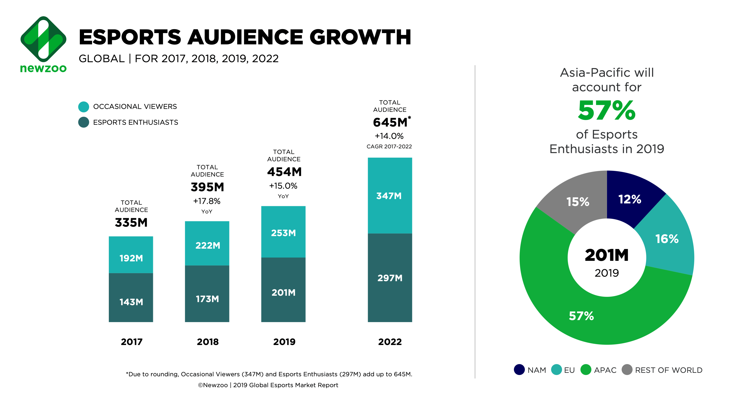
VIEWERSHIP FREQUENCY AND ENGAGEMENT TIMES ARE STAGGERING AND UNPARALLELED

Slide 6
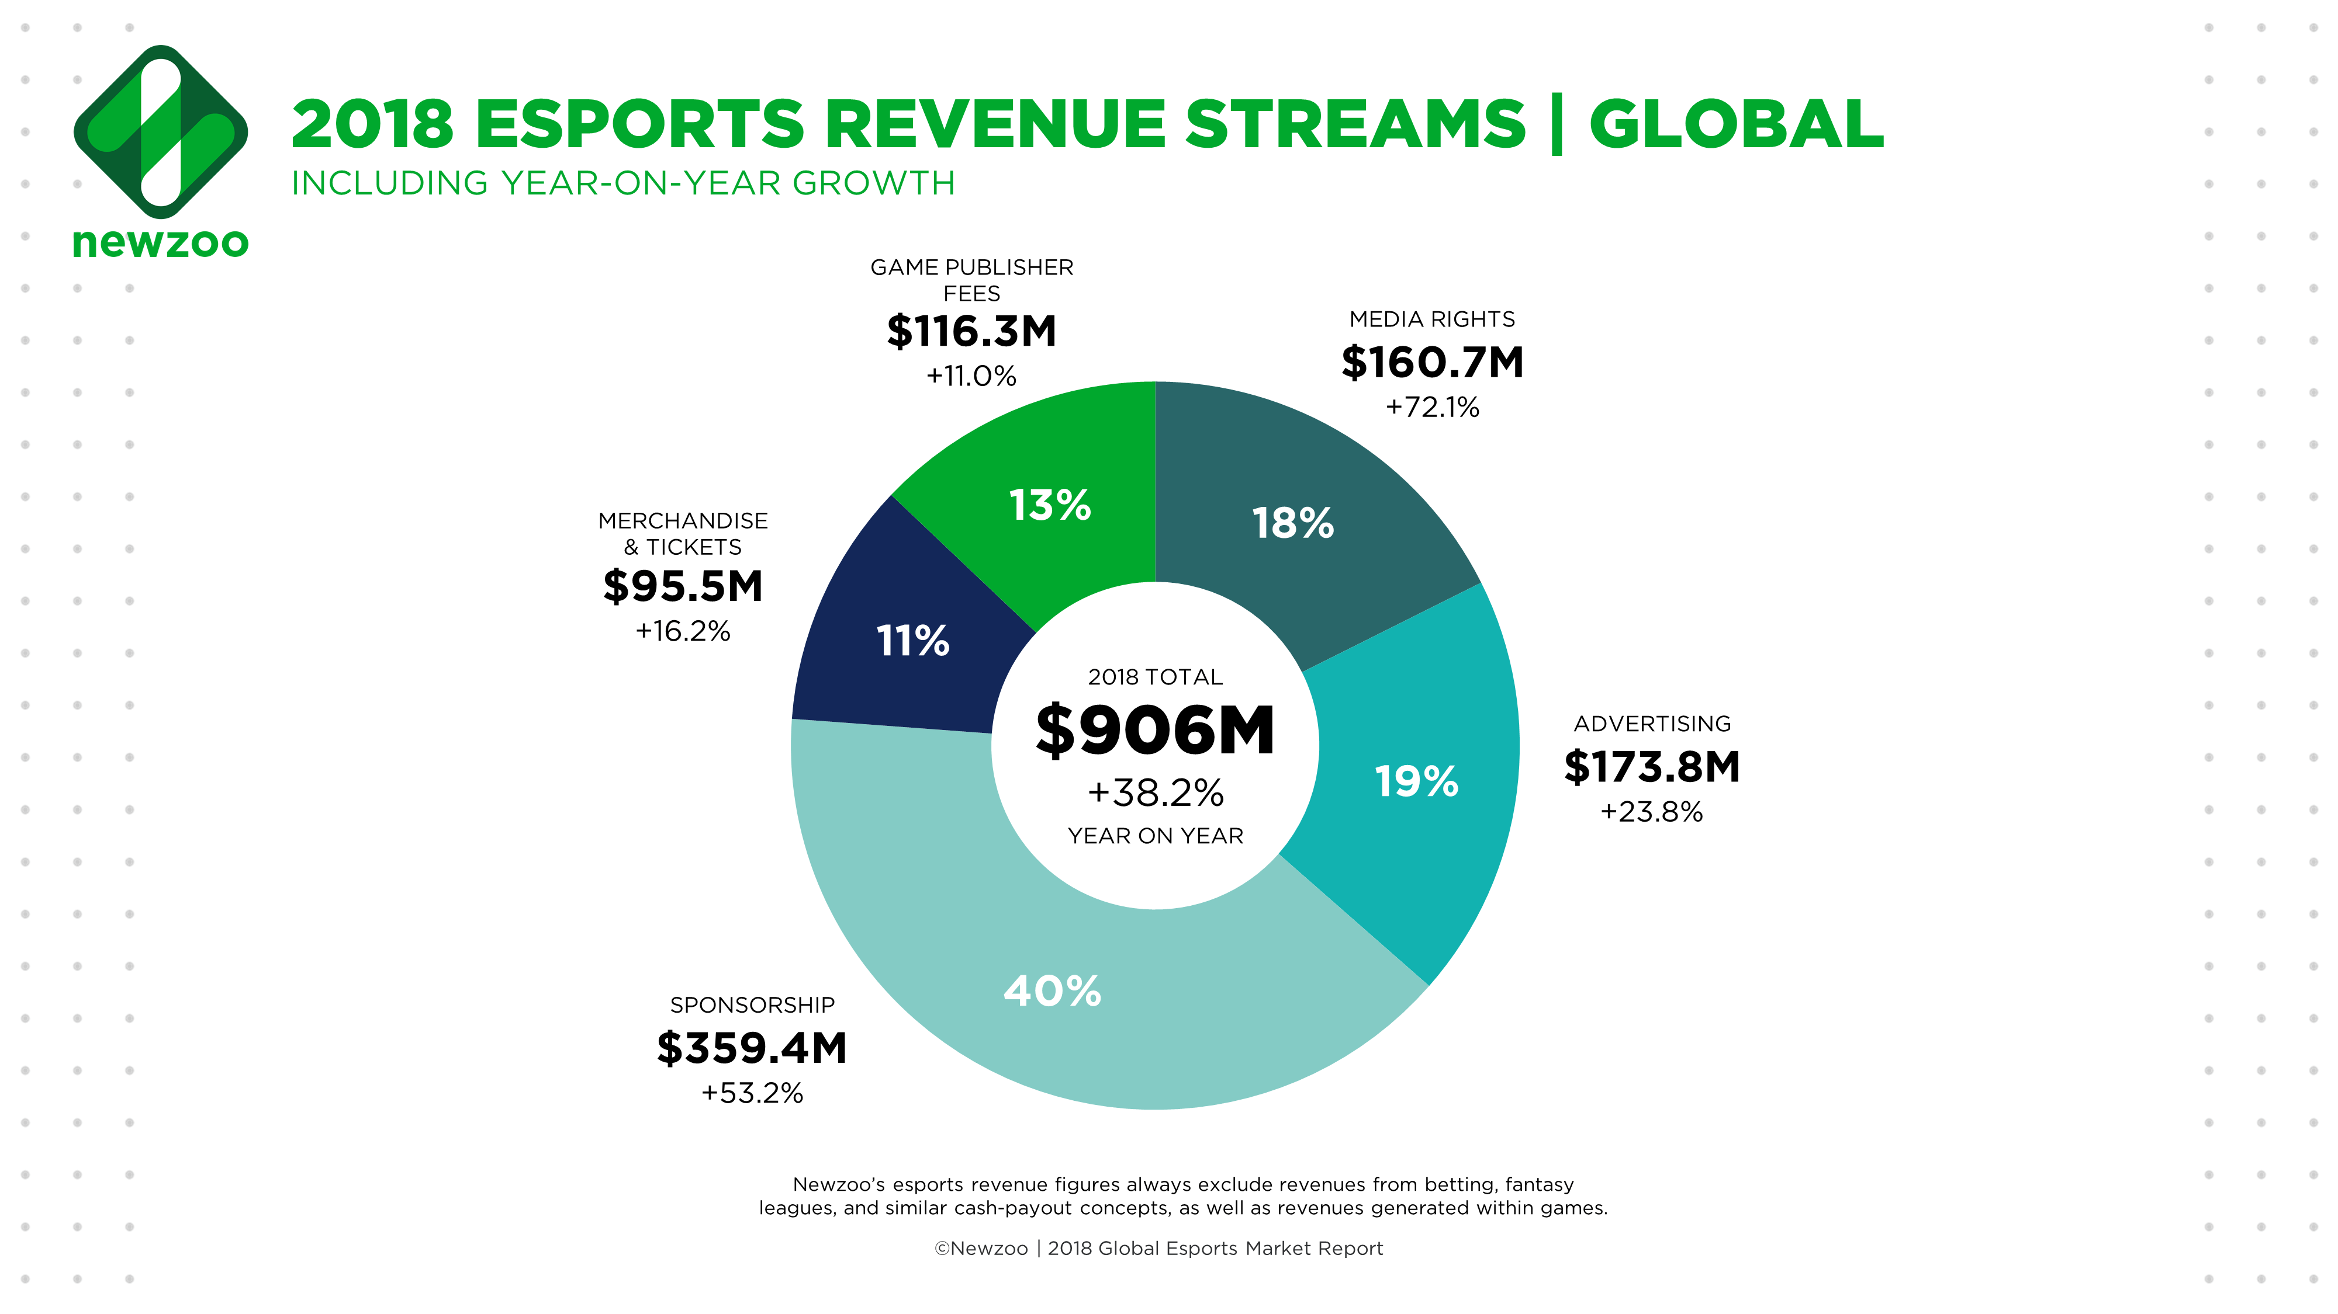

Slide 7

PLAYERS ARE CELEBRITIES

Slide 8
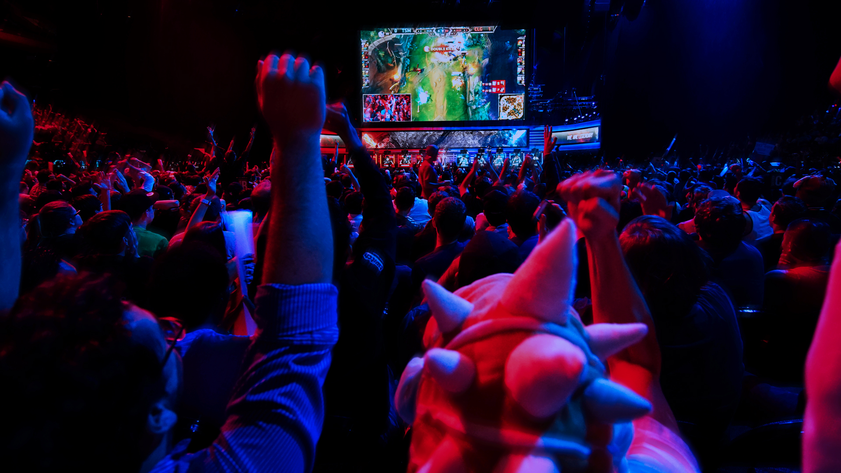
THEY TRAIN FOR HOURS EVERY DAY AND MILLIONS WATCH THEM COMPETE TO BE THE BEST IN THE WORLD. THEY HAVE PAID SPONSORSHIPS AND, FAN CLUBS AND SOMETIMES EVEN GROUPIES.

Slide 9

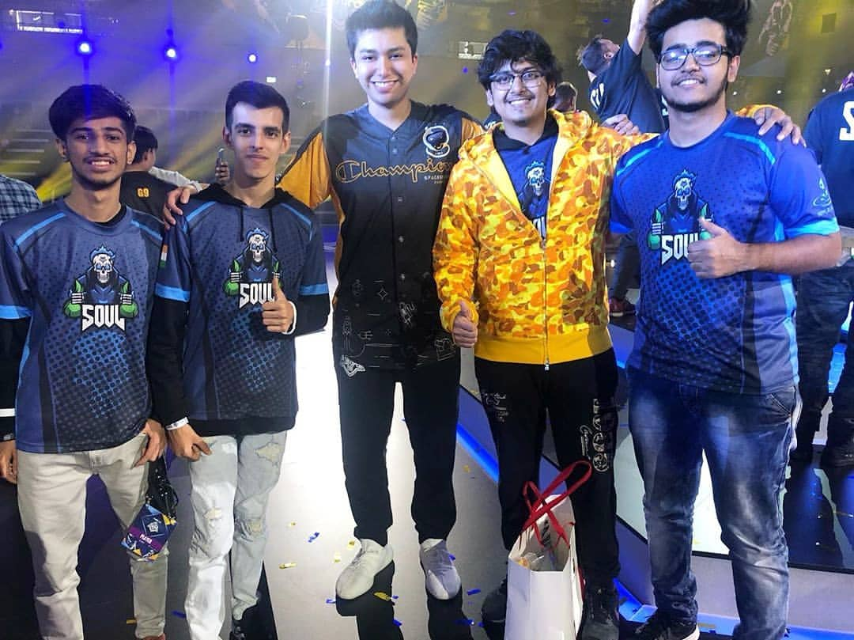
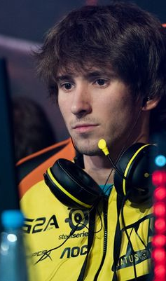
HOSTYN
“STARCRAFT 2”
MORTAL
“PUBGM”
ISHUTIN
“DOTA 2”

Slide 10
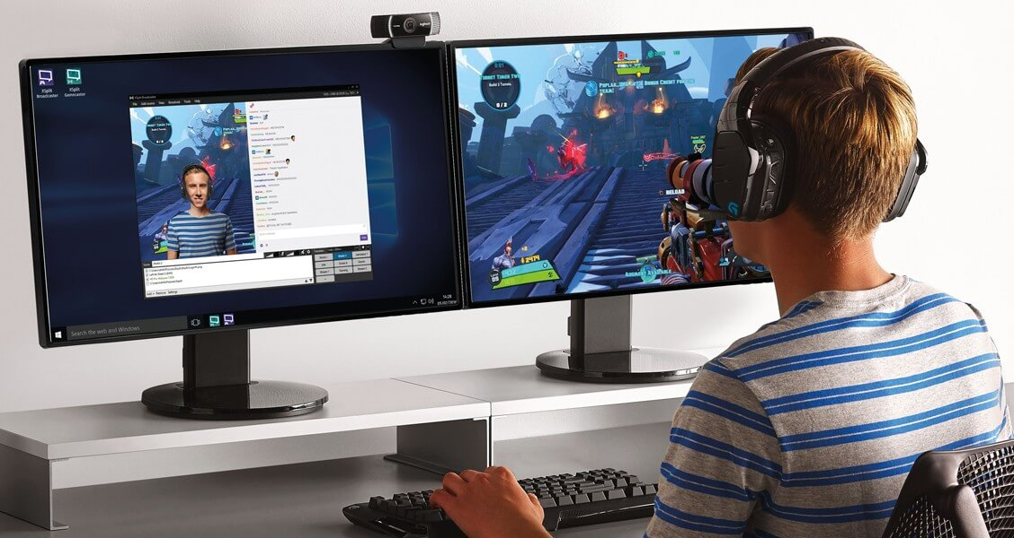
THE POPULARITY OF eSPORTS IS FUELED BY THE GROWTH OF ONLINE STREAMING CHANNELS.
TWITCH
It is the world’s leading video platform and community for gamers with more than 60 million visons per month. It connects gamers around the world by allowing them to broadcast, watch and chat from everywhere they play.
MLG
It is #1 online broadcasting network for professional level competitive gaming.
YOUTUBE
Gaming from YouTube ranges from casual to competitive. Competing streaming services also place their content on YouTube.

Slide 11


CLASSIFICATION AS A SPORT
Labeling video games as sports is a controversial point of debate. Many people contend that video games will never reach the status of "true sports". Some argue that "careful planning, precise timing, and skillful execution" ought to be what classifies an activity as sport, and that physical exertion and outdoor playing areas are not required by all traditional or non-traditional "sports".
China was one of the first countries to recognize esport as a real sport in 2003.Through this, the government encouraged esport, stating that by participating in esports, players were also "training the body for China". Further, by early 2019, China recognized esports players as a official profession within the Ministry of Human Resources and Social Security’s Occupation Skill Testing Authority recommendations, as well as professional gaming operators, those that distribute and manage esports games. By July 2019, more than 100,000 people had registered themselves as professional gamers under this, with the Ministry stating that they anticipate over 2 million such people in this profession in five years.

Slide 12
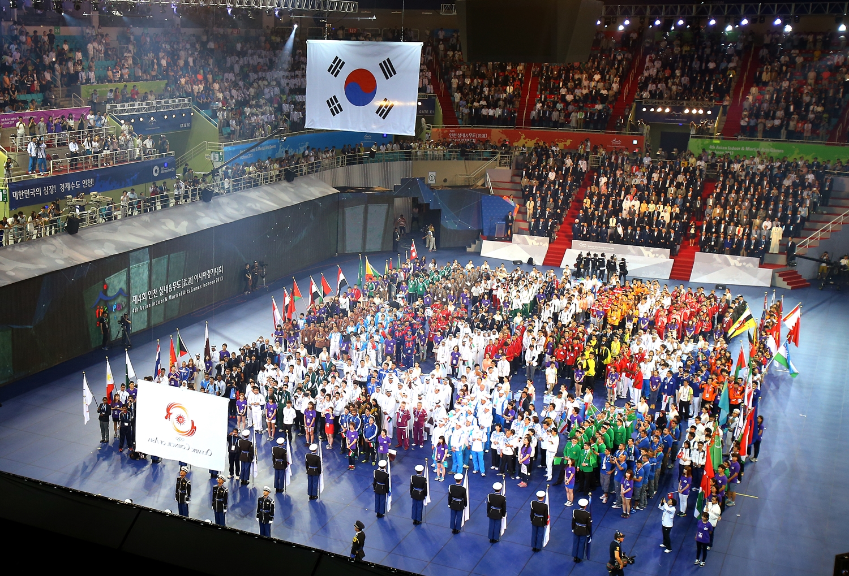

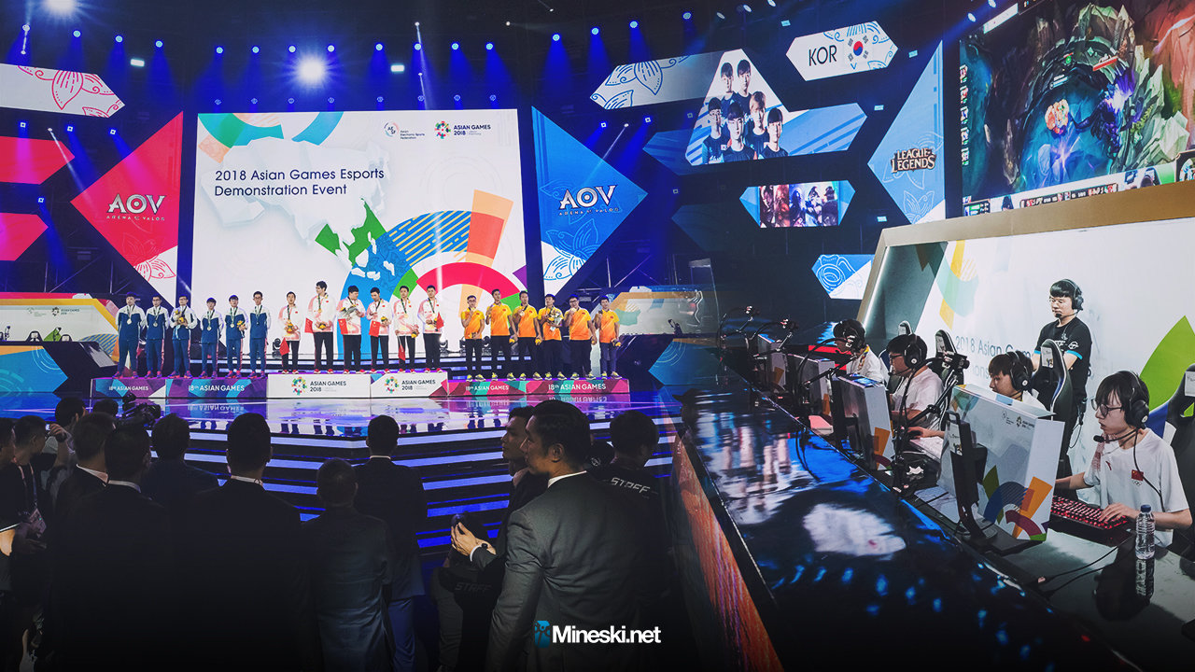
To help promote esports as a legitimate sport, several esports events have been run alongside more traditional international sport competitions. The 2007 Asian Indoor Games was the first notable multi-sport competition including esports as an official medal-winning event alongside other traditional sports, and the later editions of the Asian Indoor Games and its successor the Asian Indoor and Martial Arts Games have always included esports as an official medal event or an exhibition event up to now.

Slide 13
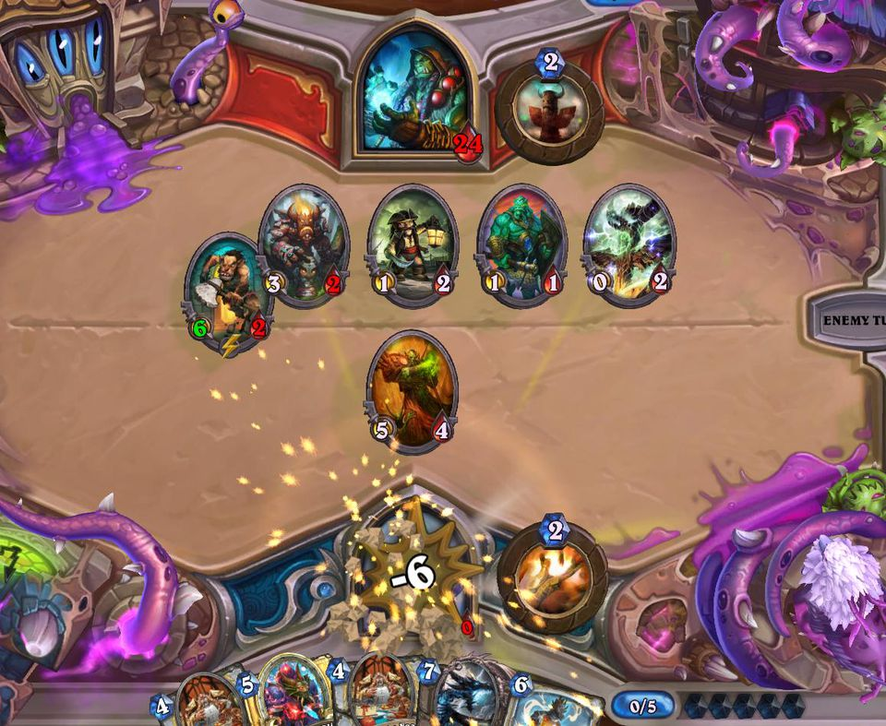


Moreover, the Asian Games, which is the Asian top-level multi-sport competition, will also include esports as a medal event at the 2022 edition; esports around games such as Hearthstone, StarCraft II, and League of Legends were presented as an exhibition event at the 2018 Asian Games as a lead-in to the 2022 games.[ The 2019 Southeast Asian Games will include six medal events for esports.

Slide 14



